Slide 1
Hinrich Schütze and Christina Lioma
Lecture 10: XML Retrieval

Slide 2
Overview
Introduction
Basic XML concepts
Challenges in XML IR
Vector space model for XML IR
Evaluation of XML IR

Slide 3
Outline
Introduction
Basic XML concepts
Challenges in XML IR
Vector space model for XML IR
Evaluation of XML IR

Slide 4
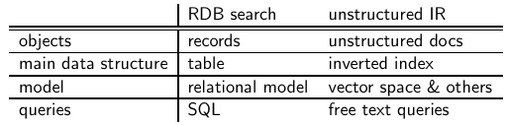
IR and relational databases
IR systems are often contrasted with relational databases (RDB).
Traditionally, IR systems retrieve information from unstructured text (“raw” text without markup).
RDB systems are used for querying relational data: sets of records that have values for predefined attributes such as employee number, title and salary.
Some structured data sources containing text are best modeled as structured documents rather than relational data (Structured retrieval).
4

Slide 5
Structured retrieval
Basic setting: queries are structured or unstructured; documents are structured.
Applications of structured retrieval
Digital libraries, patent databases, blogs, tagged text with entities like persons and locations (named entity tagging)
Example
Digital libraries: give me a full-length article on fast fourier transforms Patents: give me patens whose claims mention RSA public key encryption and that cite US patent 4,405,829 Entity-tagged text: give me articles about sightseeing tours of the Vatican and the Coliseum
5

Slide 6
Why RDB is not suitable in this case
Three main problems
An unranked system (DB) would return a potentially large number of articles that mention the Vatican, the Coliseum and sightseeing tours without ranking them by relevance to query.
Difficult for users to precisely state structural constraints – may not know which structured elements are supported by the system.
tours AND (COUNTRY: Vatican OR
LANDMARK: Coliseum)?
tours AND (STATE: Vatican OR BUILDING: Coliseum)?
Users may be completely unfamiliar with structured search and advanced search interfaces or unwilling to use them.
Solution: adapt ranked retrieval to structured documents to address these problems.

Slide 7
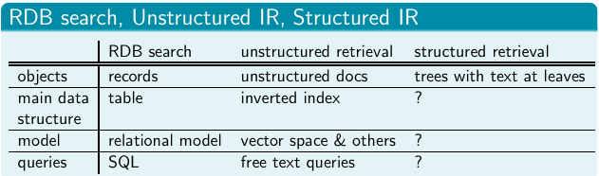
Structured Retrieval
Standard for encoding structured documents: Extensible Markup Language (XML)
structured IR XML IR
also applicable to other types of markup (HTML, SGML, …)
7

Slide 8
Outline
Introduction
Basic XML concepts
Challenges in XML IR
Vector space model for XML IR
Evaluation of XML IR

Slide 9
XML document
Ordered, labeled tree
Each node of the tree is an XML element, written with an opening and closing XML tag (e.g. <title…>, </title…>)
An element can have one or more XML attributes (e.g. number)
Attributes can have values (e.g. vii)
Attributes can have child elements (e.g. title, verse)
<play>
<author>Shakespeare</author>
<title>Macbeth</title>
<act number=“I”>
<scene number=“”vii”>
<title>Macbeth’s castle</title>
<verse>Will I with wine
…</verse>
</scene>
</act>
</play>
9

Slide 10
XML document
root element
play
element
author
element
act
element
title
text
Shakespeare
text
Macbeth
attribute
number=“I”
element
scene
attribute number=“vii”
element
verse
element
title
text
Shakespeare
text
Macbeth’s castle
10

Slide 11
XML document
The leaf nodes
consist of text
root element
play
element
author
element
act
element
title
text
Shakespeare
text
Macbeth
attribute
number=“I”
element
scene
attribute number=“vii”
element
verse
element
title
text
Shakespeare
text
Macbeth’s castle
11

Slide 12
XML document
The internal nodes encode
document structure or
metadata functions
root element
play
element
author
element
act
element
title
text
Shakespeare
text
Macbeth
attribute
number=“I”
element
scene
attribute number=“vii”
element
verse
element
title
text
Shakespeare
text
Macbeth’s castle
12

Slide 13
XML basics
XML Documents Object Model (XML DOM): standard for accessing and processing XML documents
The DOM represents elements, attributes and text within elements as nodes in a tree.
With a DOM API, we can process an XML documents by starting at the root element and then descending down the tree from parents to children.
XPath: standard for enumerating path in an XML document collection.
We will also refer to paths as XML contexts or simply contexts
Schema: puts constraints on the structure of allowable XML documents. E.g. a schema for Shakespeare’s plays: scenes can occur as children of acts.
Two standards for schemas for XML documents are: XML DTD (document type definition) and XML Schema.
13

Slide 14
Outline
Introduction
Basic XML concepts
Challenges in XML IR
Vector space model for XML IR
Evaluation of XML IR

Slide 15
First challenge: document parts to retrieve
Structured or XML retrieval: users want us to return parts of documents (i.e., XML elements), not entire documents as IR systems usually do in unstructured retrieval.
In this case, the user is probably looking for the scene.
However, an otherwise unspecified search for Macbeth should return the play of this name, not a subunit.
Solution: structured document retrieval principle
Example
If we query Shakespeare’s plays for Macbeth’s castle, should we return the scene, the act or the entire play?
15

Slide 16
Structured document retrieval principle
Motivates a retrieval strategy that returns the smallest unit that contains the information sought, but does not go below this level.
Hard to implement this principle algorithmically. E.g. query: title:Macbeth can match both the title of the tragedy, Macbeth, and the title of Act I, Scene vii, Macbeth’s castle.
But in this case, the title of the tragedy (higher node) is preferred.
Difficult to decide which level of the tree satisfies the query.
Structured document retrieval principle
One criterion for selecting the most appropriate part of a document: A system should always retrieve the most specific part of a document answering the query.
16

Slide 17
Second challenge: document parts to index
Central notion for indexing and ranking in IR: documents unit or
indexing unit.
In unstructured retrieval, usually straightforward: files on your desktop, email massages, web pages on the web etc.
In structured retrieval, there are four main different approaches to defining the indexing unit
non-overlapping pseudodocuments
top down
bottom up
all

Slide 18
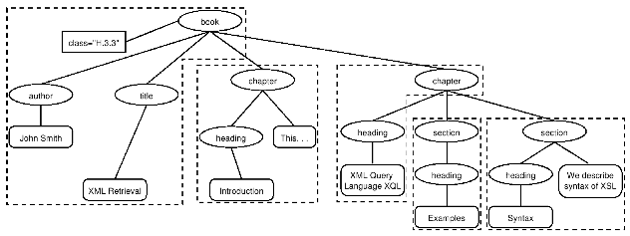
XML indexing unit: approach 1
Group nodes into non-overlapping pseudodocuments.
Indexing units: books, chapters, section, but without overlap.
Disadvantage: pseudodocuments may not make sense to the user
because they are not coherent units.

Slide 19
XML indexing unit: approach 2
Top down (2-stage process):
Start with one of the latest elements as the indexing unit, e.g. the book element in a collection of books
Then, postprocess search results to find for each book the subelement that is the best hit.
This two-stage retrieval process often fails to return the best
subelement because the relevance of a whole book is often not a
good predictor of the relevance of small subelements within it.

Slide 20
XML indexing unit: approach 3
Bottom up:
Instead of retrieving large units and identifying subelements (top
down), we can search all leaves, select the most relevant ones and
then extend them to larger units in postprocessing.
Similar problem as top down: the relevance of a leaf element is
often not a good predictor of the relevance of elements it is
contained in.

Slide 21
XML indexing unit: approach 4
Index all elements: the least restrictive approach. Also problematic:
Many XML elements are not meaningful search results, e.g., an ISBN number.
Indexing all elements means that search results will be highly redundant.
We call elements that are contained within each other nested elements. Returning redundant nested elements in a list of returned hits is not very user-friendly.
Example
For the query Macbeth’s castle we would return all of the play, act, scene and title elements on the path between the root node and Macbeth’s castle. The leaf node would then occur 4 times in the result set: 1 directly and 3 as part of other elements.
21

Slide 22
Third challenge: nested elements
Because of the redundancy caused by the nested elements it is
common to restrict the set of elements eligible for retrieval.
Restriction strategies include:
discard all small elements
discard all element types that users do not look at (working XML retrieval system logs)
discard all element types that assessors generally do not judge to be relevant (if relevance assessments are available)
only keep element types that a system designer or librarian has deemed to be useful search results
In most of these approaches, result sets will still contain nested
elements.

Slide 23
Third challenge: nested elements
Further techniques:
remove nested elements in a postprocessing step to reduce redundancy.
collapse several nested elements in the results list and use highlighting of query terms to draw the user’s attention to the relevant passages.
Highlighting
Gain 1: enables users to scan medium-sized elements (e.g., a section); thus, if the section and the paragraph both occur in the results list, it is sufficient to show the section. Gain 2: paragraphs are presented in-context (i.e., their embedding section). This context may be helpful in interpreting the paragraph.

Slide 24
Nested elements and term statistics
Further challenge related to nesting: we may need to distinguish different contexts of a term when we compute term statistics for ranking, in particular inverse document frequency (idf ).
Solution: compute idf for XML-context term pairs.
sparse data problems (many XML-context pairs occur too rarely to reliably estimate df)
compromise: consider the parent node x of the term and not the rest of the path from the root to x to distinguish contexts.
Example
The term Gates under the node author is unrelated to an occurrence under a content node like section if used to refer to the plural of gate. It makes little sense to compute a single document frequency for Gates in this example.

Slide 25
Outline
Introduction
Basic XML concepts
Challenges in XML IR
Vector space model for XML IR
Evaluation of XML IR

Slide 26
Main idea: lexicalized subtrees
Aim: to have each dimension of the vector space encode a word together with its position within the XML tree.
How: Map XML documents to lexicalized subtrees.
Microsoft
Bill
Gates
Book
Title
Author
Author
Title
Author
Microsoft
Bill
Gates
Microsoft
Bill
Gates
Book
Book
. . .
Title
Author
Microsoft
Bill
Gates

Slide 27
Main idea: lexicalized subtrees
Take each text node (leaf) and break it into multiple nodes, one for each word. E.g. split Bill Gates into Bill and Gates
Define the dimensions of the vector space to be lexicalized subtrees of documents – subtrees that contain at least one vocabulary term.
Microsoft
Bill
Gates
Book
Title
Author
Author
Title
Author
Microsoft
Bill
Gates
Microsoft
Bill
Gates
Book
Book
. . .
Title
Author
Microsoft
Bill
Gates

Slide 28
Lexicalized subtrees
We can now represent queries and documents as vectors in this space of lexicalized subtrees and compute matches between them,
e.g. using the vector space formalism.
Vector space formalism in unstructured VS. structured IR
The main difference is that the dimensions of vector space in unstructured retrieval are vocabulary terms whereas they are lexicalized subtrees in XML retrieval.

Slide 29
Structural term
There is a tradeoff between the dimensionality of the space and the accuracy of query results.
If we restrict dimensions to vocabulary terms, then we have a standard vector space retrieval system that will retrieve many documents that do not match the structure of the query (e.g., Gates in the title as opposed to the author element).
If we create a separate dimension for each lexicalized subtree occurring in the collection, the dimensionality of the space becomes too large.
Compromise: index all paths that end in a single vocabulary term, in other words all XML-context term pairs. We call such an XML-context term pair a structural term and denote it by <c, t>: a pair of XML-context c and vocabulary term t.

Slide 30

Context resemblance
A simple measure of the similarity of a path c_{q} in a query and a path c_{q} in a document is the following context resemblance function Cr:
|c_{q}| and |c_{d}| are the number of nodes in the query path and document path, resp.
c_{q} matches c_{d} iff we can transform c_{q} into c_{d} by inserting additional nodes.

Slide 31
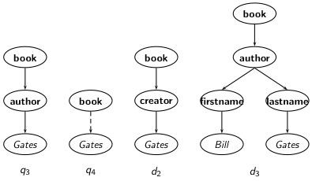
Context resemblance example
Cr(c_{q}, c_{d}) = 3/4 = 0.75. The value of Cr(c_{q}, c_{d}) is 1.0 if q and d are identical.

Slide 32
Context resemblance example
Cr(c_{q}, c_{d}) = ? Cr(c_{q}, c_{d}) = 3/5 = 0.6.

Slide 33

Document similarity measure
The final score for a document is computed as a variant of the cosine measure, which we call SimNoMerge.
SimNoMerge(q, d) =
V is the vocabulary of non-structural terms
B is the set of all XML contexts
weight (q, t, c), weight(d, t, c) are the weights of term t in XML context c in query q and document d, resp. (standard weighting e.g. idf_{t} x wf_{t,d}, where idf_{t} depends on which elements we use to compute df_{t}.)
SimNoMerge(q, d) is not a true cosine measure since its value can be larger than 1.0.

Slide 34
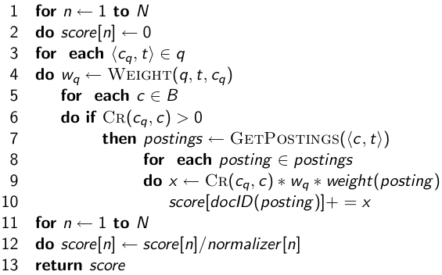
SimNoMerge algorithm
ScoreDocumentsWithSimNoMerge(q, B, V, N, normalizer)

Slide 35
Outline
Introduction
Basic XML concepts
Challenges in XML IR
Vector space model for XML IR
Evaluation of XML IR

Slide 36
Initiative for the Evaluation of XML retrieval (INEX)
INEX: standard benchmark evaluation (yearly) that has produced test collections (documents, sets of queries, and relevance judgments).
Based on IEEE journal collection (since 2006 INEX uses the much larger English Wikipedia test collection).
The relevance of documents is judged by human assessors.
INEX 2002 collection statistics
12,107 | number of documents
494 MB | size
1995—2002 | time of publication of articles
1,532 | average number of XML nodes per document
6.9 | average depth of a node
30 | number of CAS topics
30 | number of CO topics

Slide 37
INEX topics
Two types:
content-only or CO topics: regular keyword queries as in unstructured information retrieval
content-and-structure or CAS topics: have structural constraints in addition to keywords
Since CAS queries have both structural and content criteria, relevance assessments are more complicated than in unstructured retrieval

Slide 38
INEX relevance assessments
INEX 2002 defined component coverage and topical relevance as orthogonal dimensions of relevance.
Component coverage
Evaluates whether the element retrieved is “structurally” correct, i.e., neither too low nor too high in the tree.
We distinguish four cases:
Exact coverage (E): The information sought is the main topic of the component and the component is a meaningful unit of information.
Too small (S): The information sought is the main topic of the component, but the component is not a meaningful (self-contained) unit of information.
Too large (L): The information sought is present in the component, but is not the main topic.
No coverage (N): The information sought is not a topic of the component.

Slide 39
INEX relevance assessments
The topical relevance dimension also has four levels: highly relevant (3), fairly relevant (2), marginally relevant (1) and nonrelevant (0).
Combining the relevance dimensions
Components are judged on both dimensions and the judgments are then combined into a digit-letter code, e.g. 2S is a fairly relevant component that is too small. In theory, there are 16 combinations of coverage and relevance, but many cannot occur. For example, a nonrelevant component cannot have exact coverage, so the combination 3N is not possible.

Slide 40
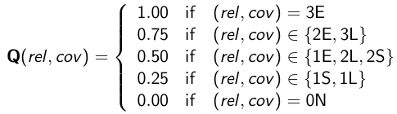

INEX relevance assessments
The relevance-coverage combinations are quantized as follows:
This evaluation scheme takes account of the fact that binary relevance judgments, which are standard in unstructured IR, are not appropriate for XML retrieval. The quantization function Q does not impose a binary choice relevant/nonrelevant and instead allows us to grade the component as partially relevant. The number of relevant components in a retrieved set A of components can then be computed as:

Slide 41
INEX evaluation measures
As an approximation, the standard definitions of precision and recall can be applied to this modified definition of relevant items retrieved, with some subtleties because we sum graded as opposed to binary relevance assessments.
Drawback
Overlap is not accounted for. Accentuated by the problem of multiple nested elements occurring in a search result.
Recent INEX focus: develop algorithms and evaluation measures that return non-redundant results lists and evaluate them properly.

Slide 42
Recap
Structured or XML IR: effort to port unstructured (standard) IR know-how onto a scenario that uses structured (DB-like) data
Specialized applications (e.g. patents, digital libraries)
A decade old, unsolved problem
http://inex.is.informatik.uni-duisburg.de/

